Slide 1

ECOMMERCE Data Engineering Project
Notes:
AI-generated content may be incorrect. ---

Slide 2






TEAM
Vukyam Hemanth
Data Engineer
Tiyyagura Nikitha
Data Engineer
Venkat Satyanarayana
Scrum Master
Poreddy Geethika
Data Engineer
Shreya Vishwakarma
Data Engineer
Vasikarla Sowmya Sri
Data Engineer

Slide 3







CONTENTS Architecture diagram
Problem analysis
Data source
Data Ingestion
Storage & Processing
Visualization
Conclusion

Slide 4
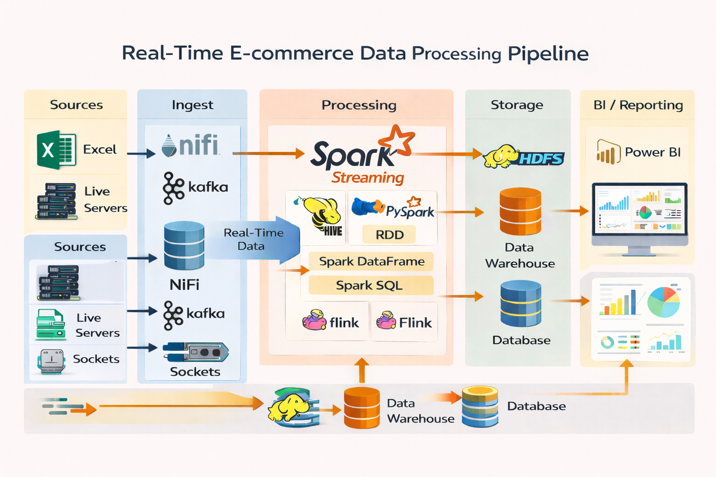
ARCHITECTURE DIAGRAM

Slide 5
PROBLEM STATEMENT
E-commerce platforms generate large volumes of real-time and batch data
Data comes from multiple heterogeneous sources (Excel, live servers, sockets)
Traditional systems fail to handle:
Real-time processing
Scalability
Low-latency analytics
Business teams need near real-time insights for:
Sales performance
Customer behavior
Order tracking and revenue analysis revenue analysis

Slide 6
OBJECTIVES
Build a scalable end-to-end big data pipeline for E-commerce analytics
Ingest both batch and streaming data reliably
Process data in real time and batch modes
Store data efficiently for analytics and reporting
Enable Power BI dashboards for business users
Ensure fault tolerance, data consistency, and performance

Slide 7
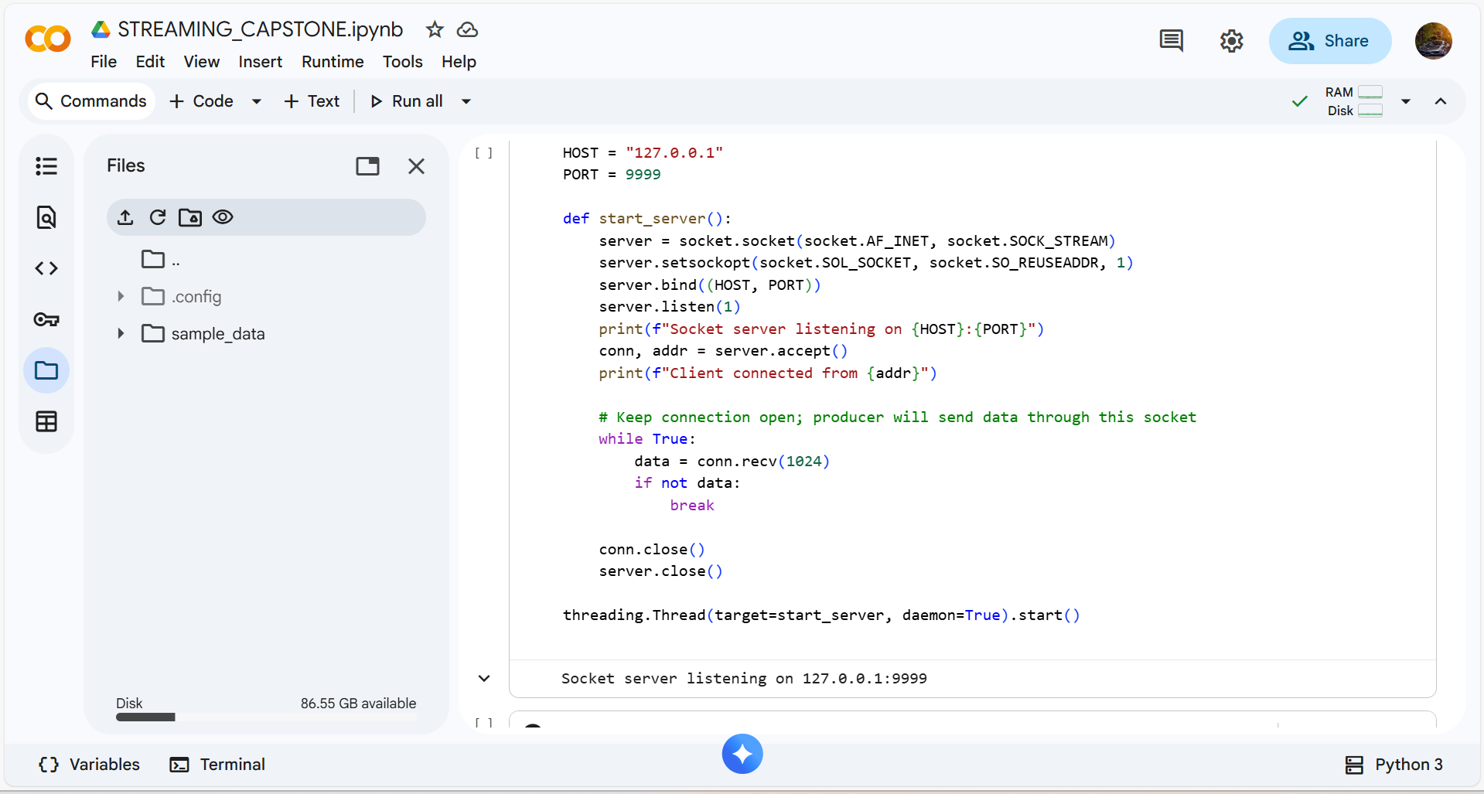
SPARK STREAMING

Slide 8
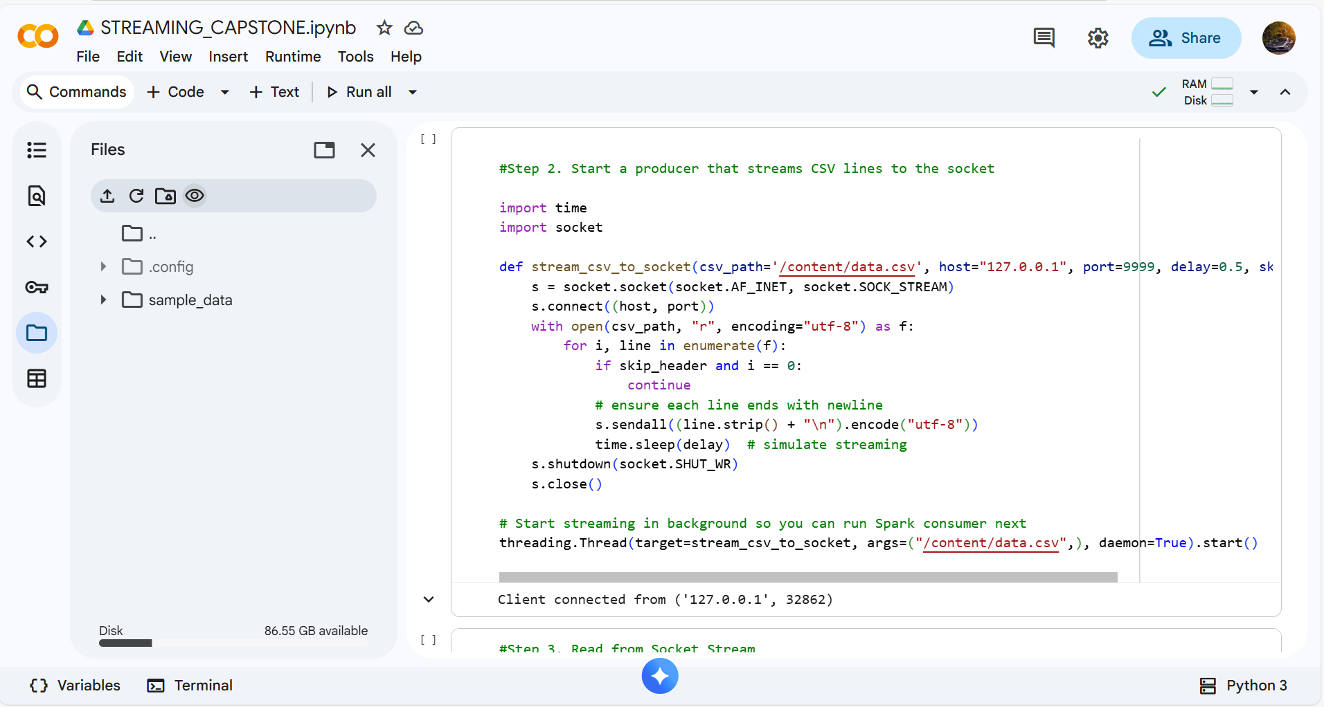
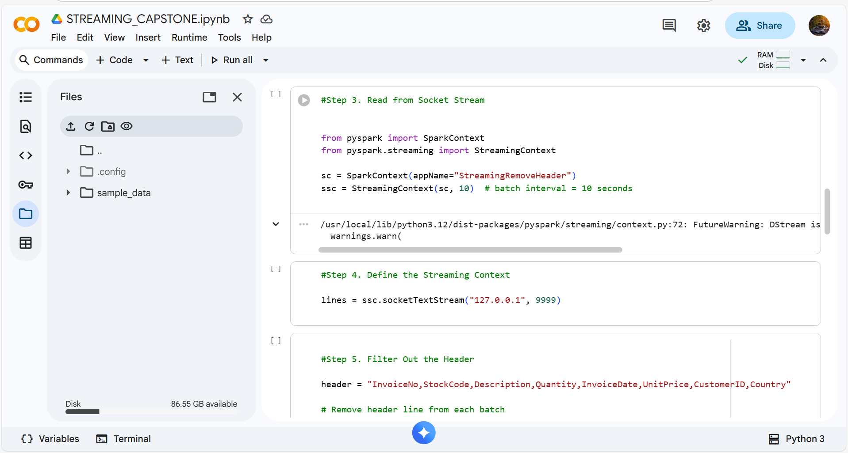
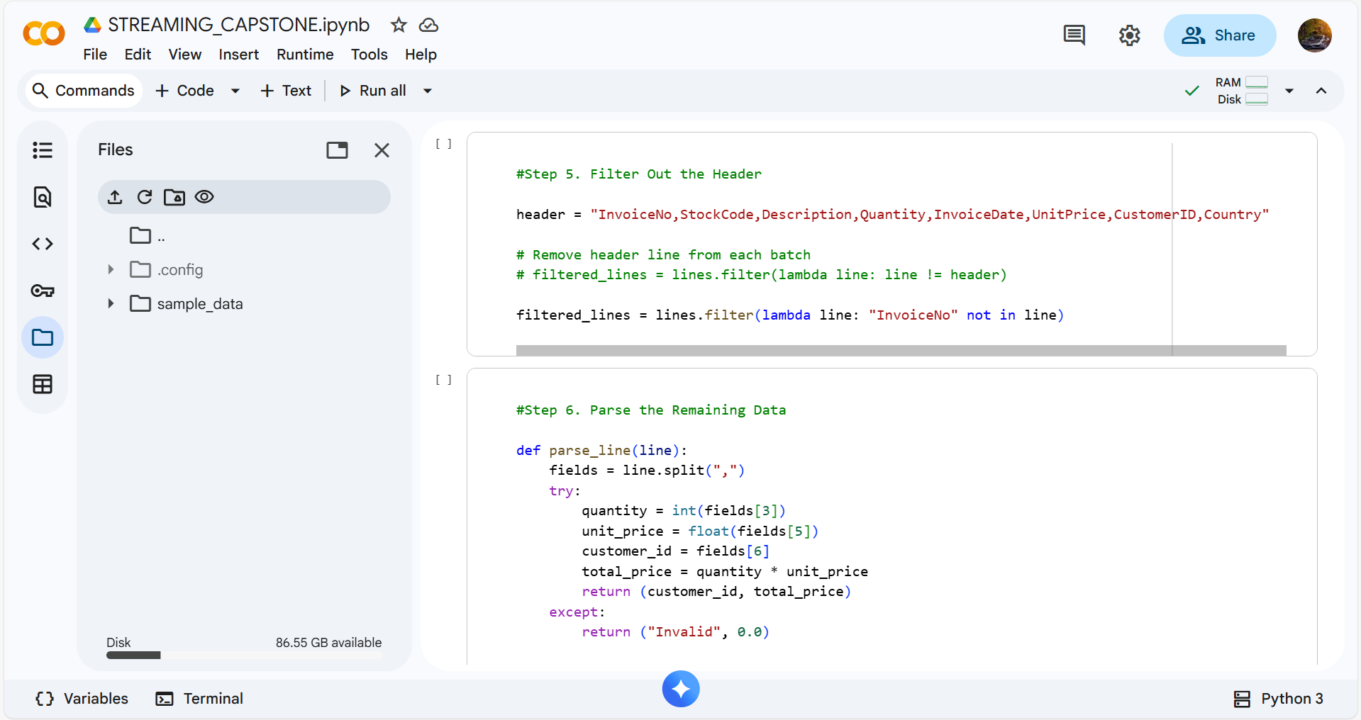
.

Slide 9
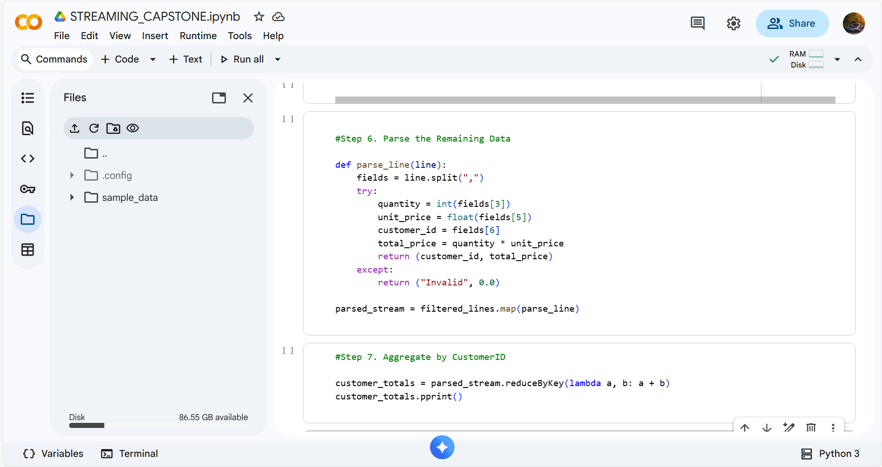
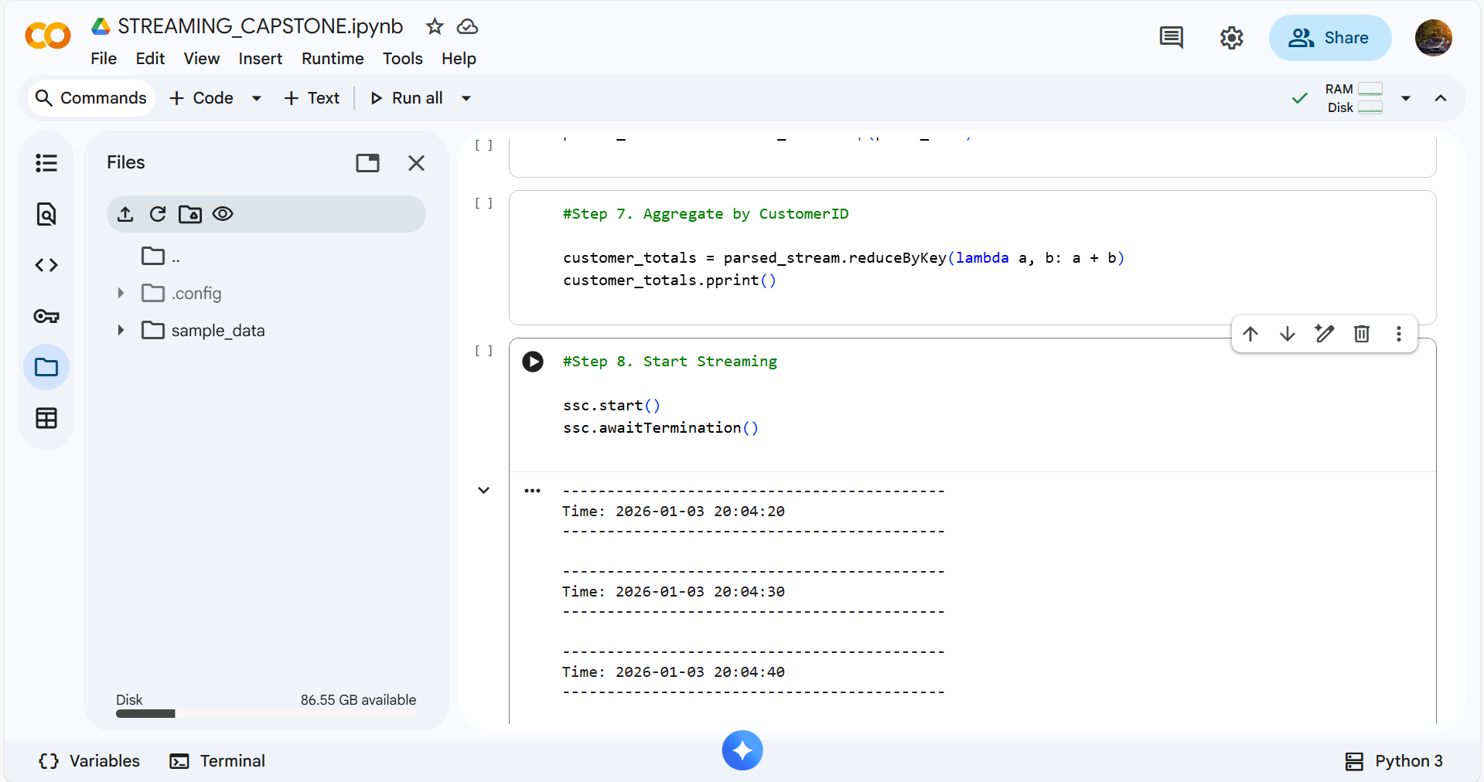
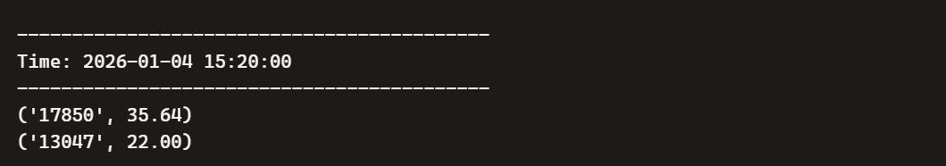
.

Slide 10
DATA SOURCES DATA.CSV

Slide 11


DATA INGESTION KAFKA NIFI

Slide 12
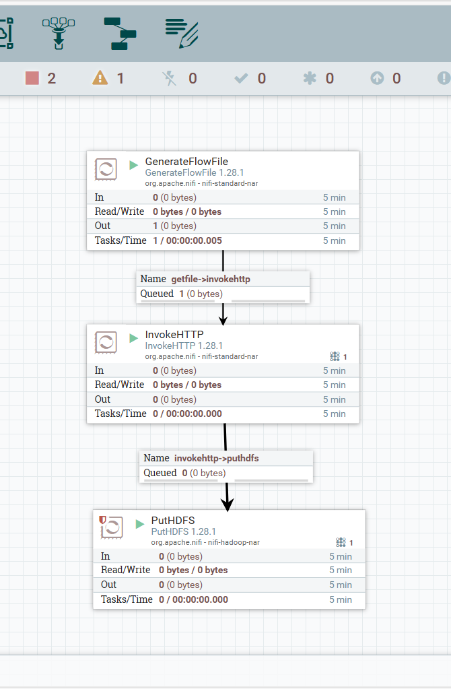
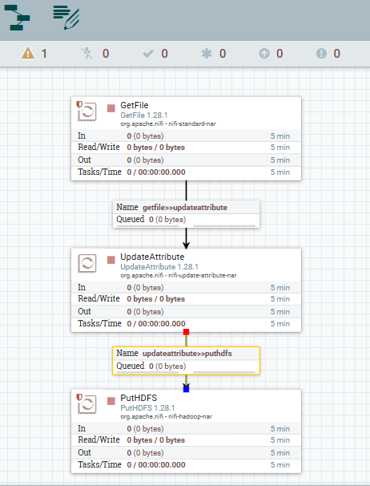
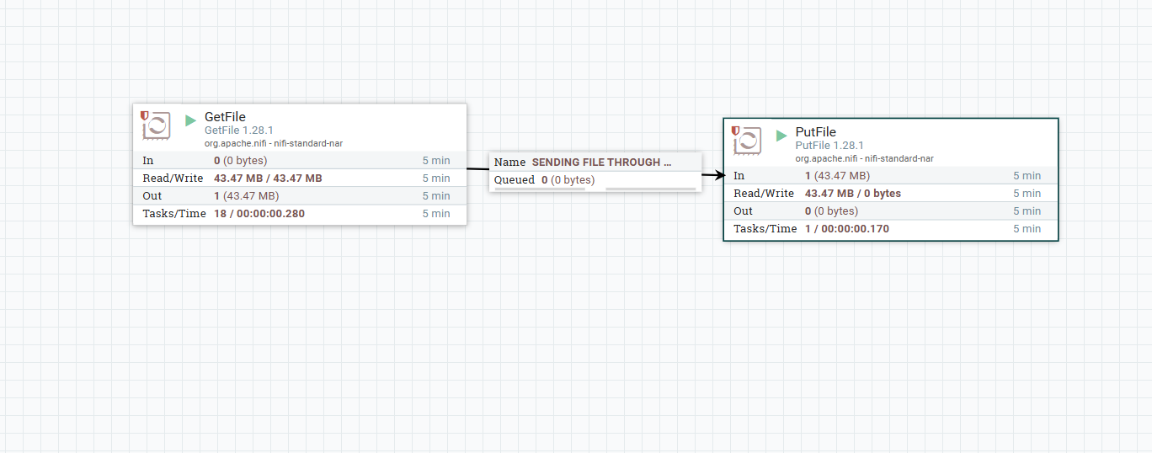
NIFI Apache NiFi is an open‑source data integration tool designed to automate and manage the flow of data between systems.
Its architecture is based on a flow‑based programming model, with core concepts like processors, connections, flowfiles, and controllers that enable ingestion, transformation, routing, and delivery of data
GETFILE - PUTHDFS
InvokeHTTP - PUTHDFS
GETFILE - PUTFILE

Slide 13
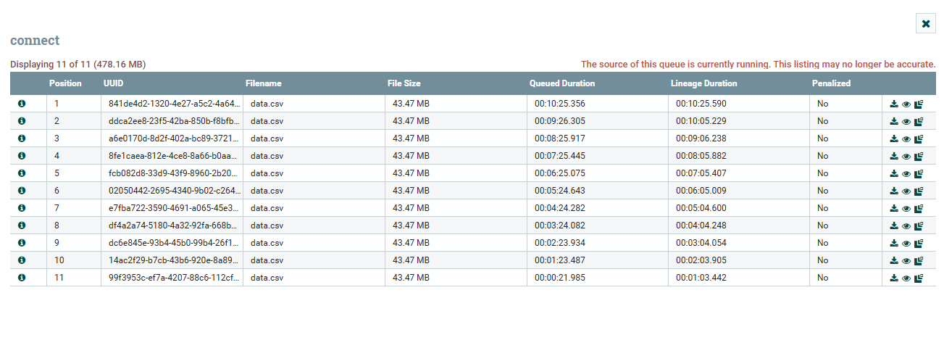
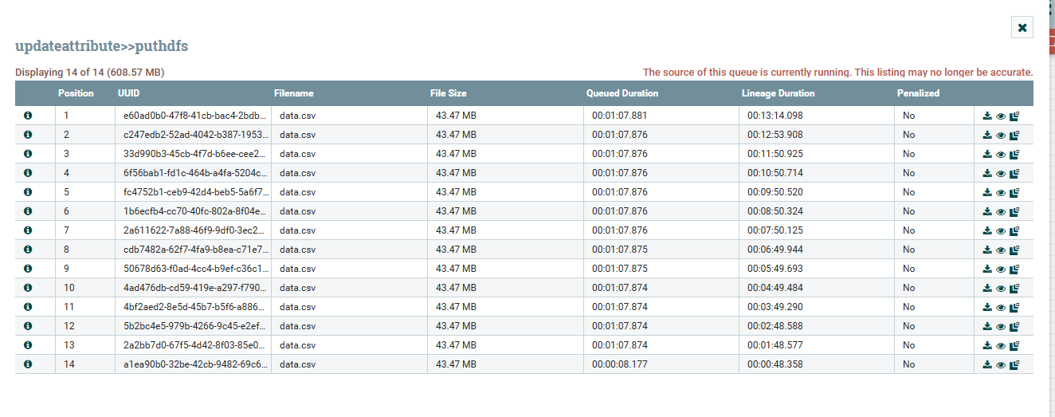
QUEUES

Slide 14
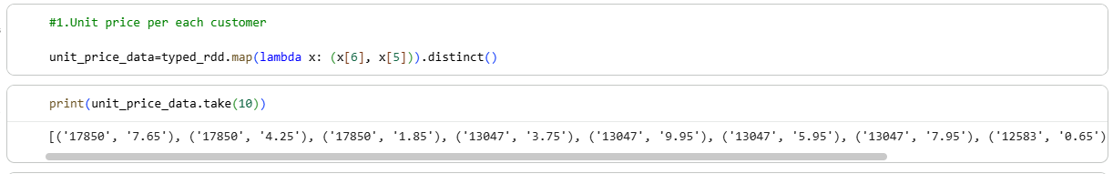
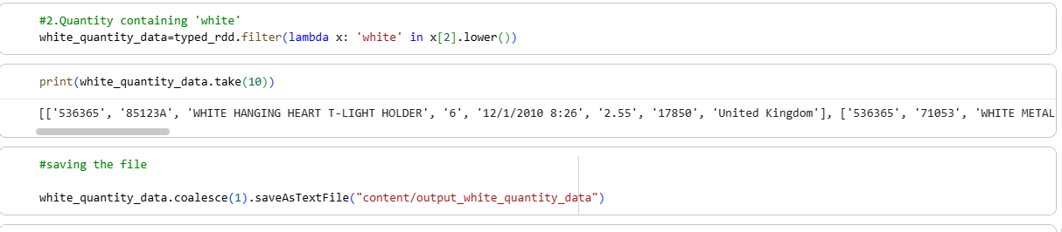
PYSPARKRDD Utilized RDD for fault-tolerant, parallel data processing.
Optimizations using Partitions & Cache → Improved performance by efficient partitioning and caching frequently accessed data to reduce recomputation.
Display the unit price of each customer.
Query to Display the data where Quantity containing white.

Slide 15
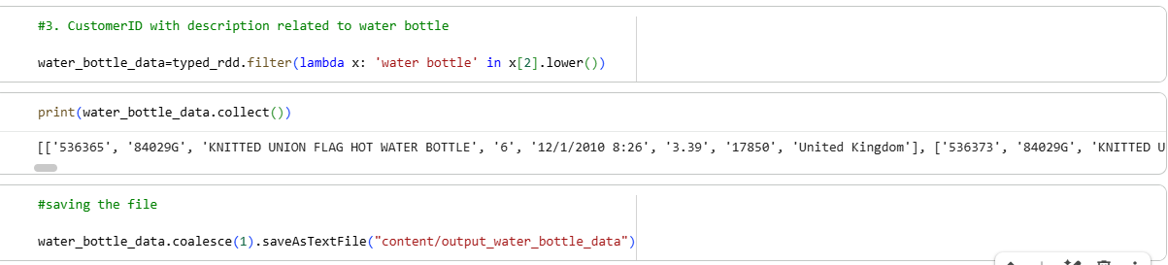
Find which customerid who has description related to water bottle

Slide 16
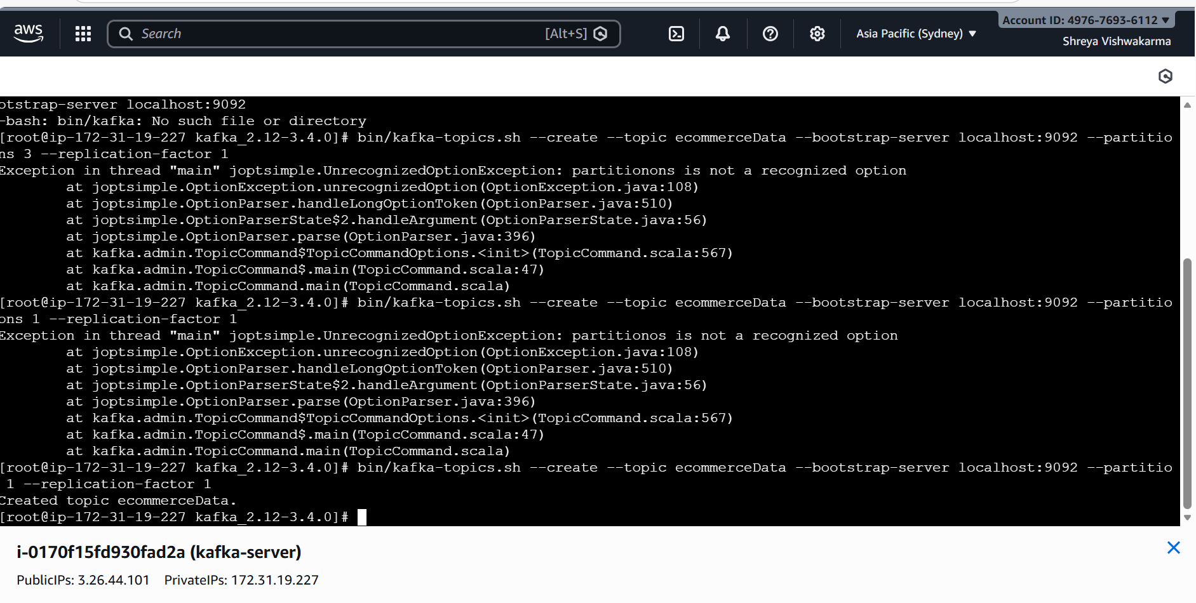
KAFKA Kafka is powerful because it can stream data in real time and is built on a robust distributed architecture that makes it reliable and scalable for modern data engineering needs.
It ensures scalability, fault tolerance, and reliable communication between systems.
Kafka is a distributed platform for real-time data streaming and processing.

Slide 17
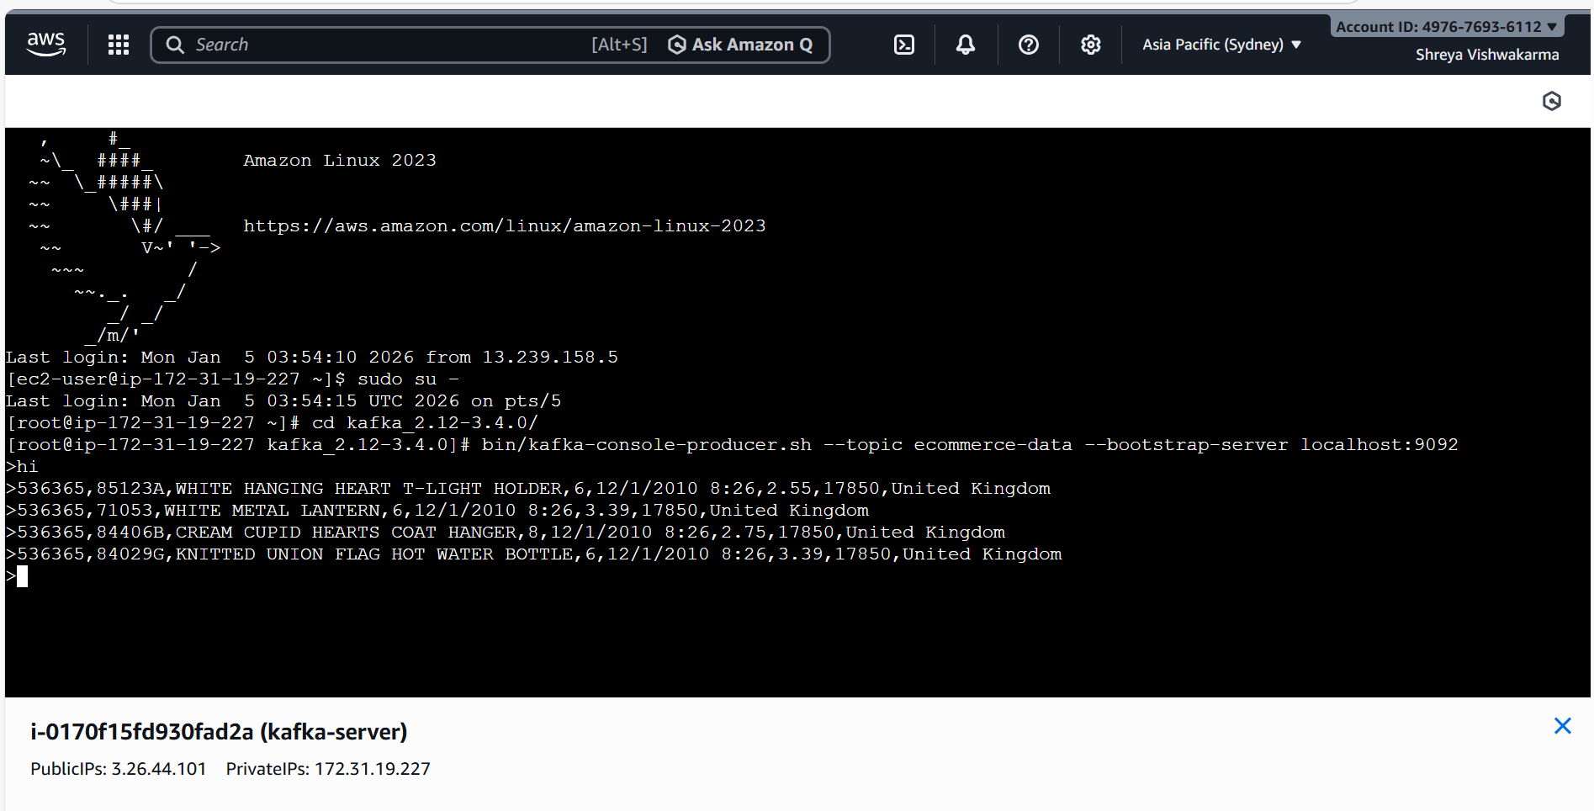
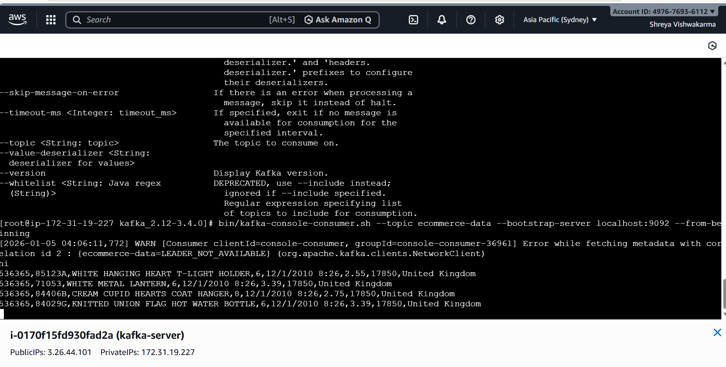
PRODUCER CONSUMER

Slide 18
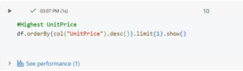
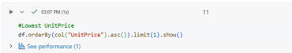
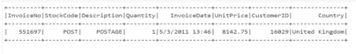
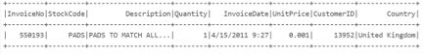
PYSPARKDF Used Parquet Format → Enabled columnar storage, compression, and faster queries by reading only required columns.
Applied Partitioning → Reduced scan size and improved query performance by filtering specific partitions.
Display the customer with highest unit price and lowest unit price.

Slide 19
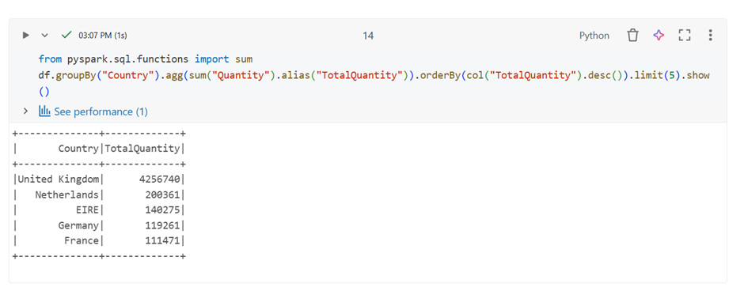
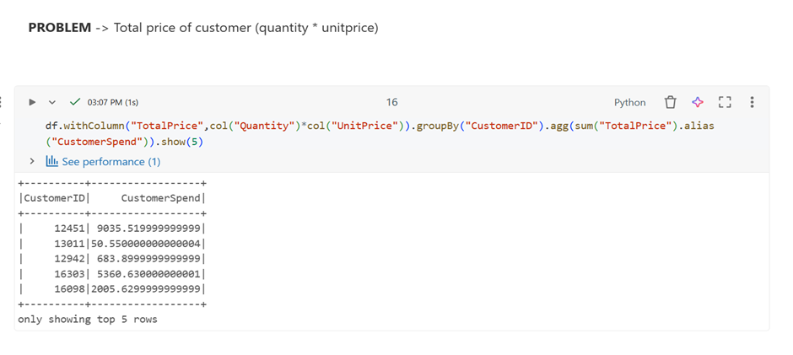
Display the top 5 countries with highest quantity in descending order. Find the total price of the customer based on the customerid given.

Slide 20
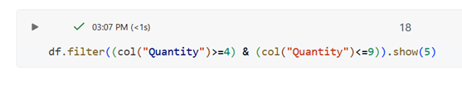
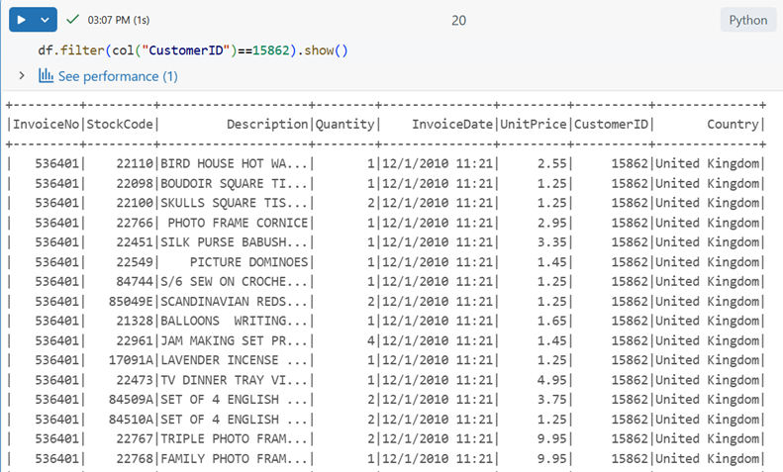
Filter out the column where quantity between 4 and 9. Filter out the column where customerID 15862

Slide 21
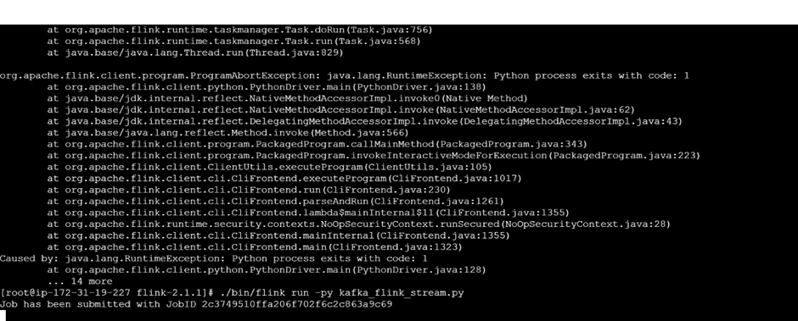
FLINK
Apache Flink is one of the most powerful frameworks for real-time stream processing
Apache Flink’s architecture is built around a distributed, fault-tolerant stream processing engine.
FLINK
KAFKA TOPIC

Slide 22
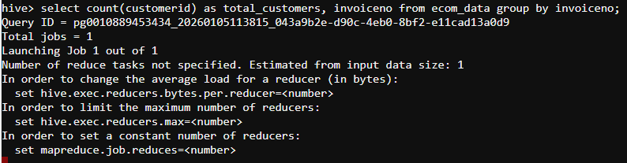
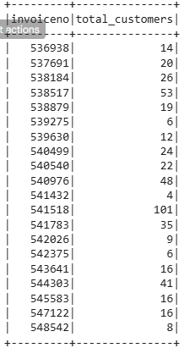
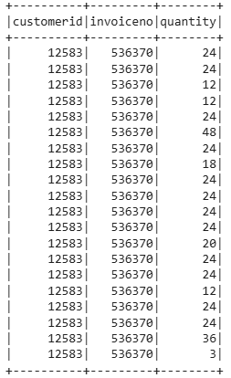
HIVE Hive provides an SQL-like interface (HiveQL) to query and analyze large datasets in Hadoop.
It is mainly used for data warehousing, ETL, and batch processing at big data scale.
Find the no.of customers in each invoiceno. Display the customerid, invoiceno, quantity in the country france.

Slide 23
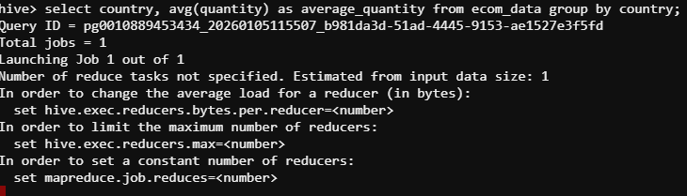
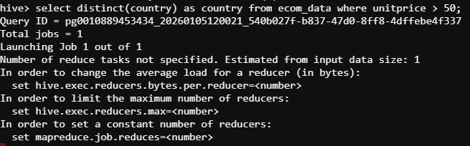
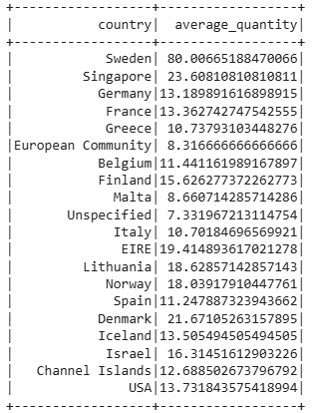
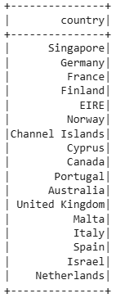
Display the average quantity of each country. Display the countries with unitprice greater than 50.

Slide 24
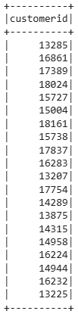
Find the customerId who are from country United Kingdom and has Invoice date at July month

Slide 25
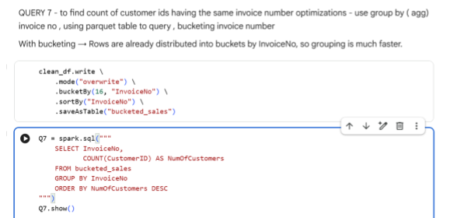
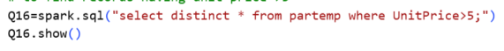
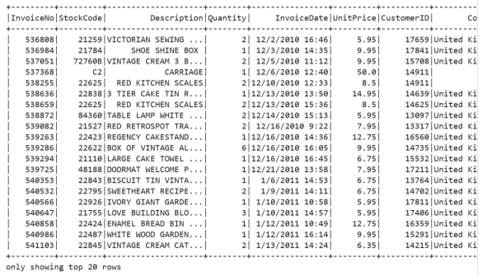
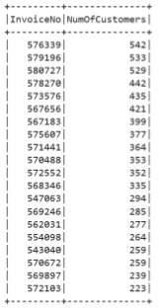
SPARKSQL Optimized Queries using Bucketing → Improved query performance by reducing shuffle operations.
Created Parquet Files → Enabled querying only on required columns, reducing unnecessary data scans.
Data Compression → Achieved smaller storage size and faster query execution.
Find the no.of customers in each invoice number. Filter out the unitPrice which has more than 5

Slide 26
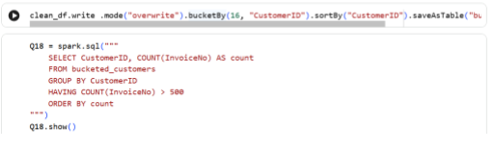
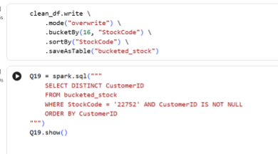
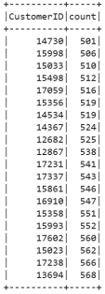
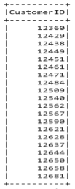
Find out the customerid who have more than 500 InvoiceNo Find out customerid who has stockcode 22752

Slide 27
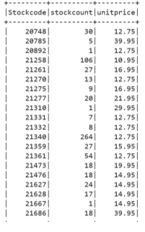
Find out the stockcode which has unitprice more than 10

Slide 28
VISUALIZATION

Slide 29
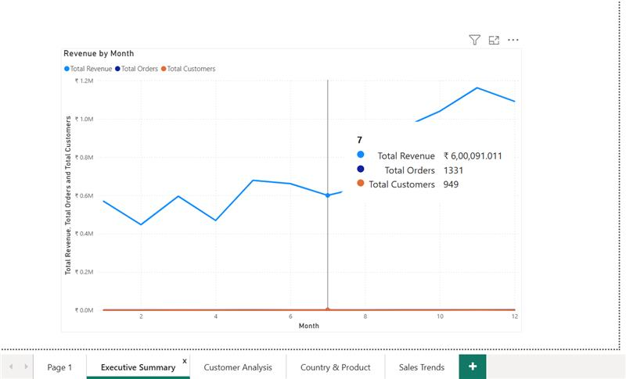
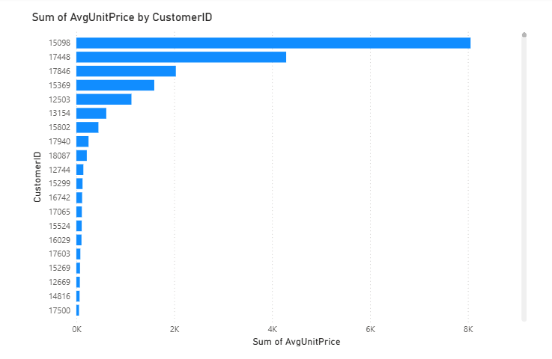
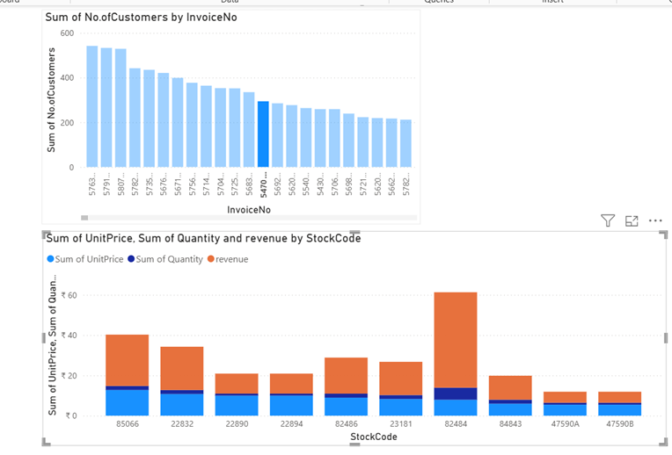
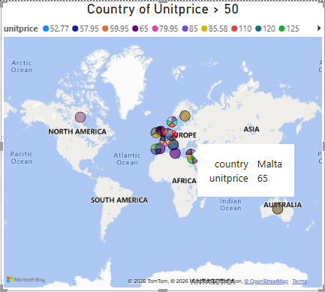
POWER BI DASHBOARD

Slide 30
CHALLENGES
Handling high-velocity streaming data from live servers
Managing data schema variations from Excel and real-time feeds
Ensuring exactly-once or at-least-once processing
Balancing real-time processing vs batch analytics
Maintaining data quality and data loss prevention
Optimizing Spark performance and resource utilization
Integrating multiple tools smoothly (NiFi, Kafka, Spark, Flink, Power BI)

Slide 31
CONCLUSION
• Successfully implemented a scalable E-commerce data pipeline • Enabled both real-time and batch analytics • Improved business visibility through Power BI dashboards • Architecture is: • Scalable • Fault-tolerant • Production-ready • Can be extended for: • Machine learning • Recommendation systems • Real-time alerts

Slide 32
THANK YOU

Slide 33

ANY QUESTIONS?

